Slide 1
Distributed File Systems
Lecturer: Ngo Huy Bien
Software Engineering Department
Faculty of Information Technology
University of Science
Ho Chi Minh City, Vietnam
nhbien@fit.hcmus.edu.vn

Slide 2

Objectives

Slide 3

Contents

Slide 4

References

Slide 5
SeaweedFS
https://github.com/seaweedfs/seaweedfs
SeaweedFS is a simple and highly scalable distributed file system.
There are two objectives:
to store billions of files!
to serve the files fast!

Slide 6
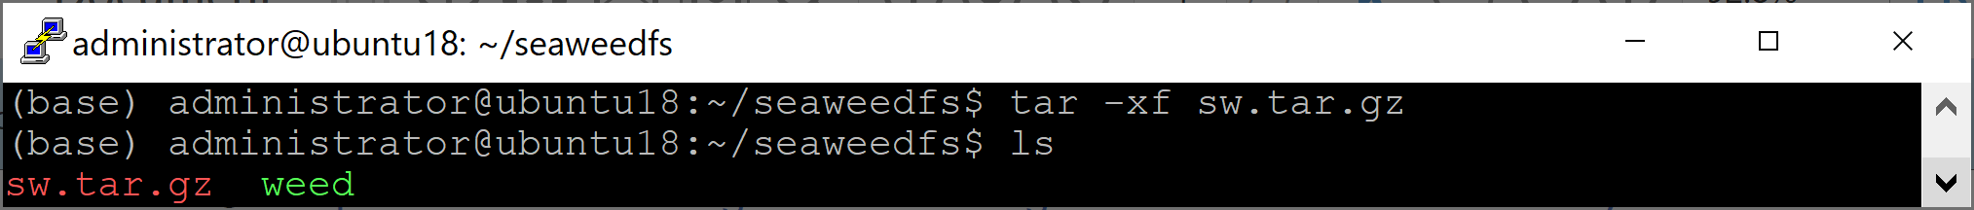
1. Download SeaweedFS
curl -L https://github.com/chrislusf/seaweedfs/releases/download/2.57/linux_amd64_large_disk.tar.gz -o sw.tar.gz
mkdir seaweedfs
sudo mv sw.tar.gz seaweedfs
cd seaweedfs
tar -xf sw.tar.gz

Slide 7
2. Start Seaweed Master
mkdir /data/sw
mkdir /data/sw/meta
cd seaweedfs
./weed master -defaultReplication=001 -mdir=/data/sw/meta
http://192.168.1.19:9333/
./weed master -defaultReplication=001 -mdir=/data/sw/meta &

Slide 8
3. Start Seaweed Volume
mkdir /data/sw/volume
cd seaweedfs
./weed volume -dir=/data/sw/volume -mserver=192.168.1.19:9333 -port=8888
http://192.168.1.19:8888
./weed volume -dir=/data/sw/volume -mserver=192.168.1.19:9333 -port=8888 &

Slide 9
NATS Streaming Server
https://github.com/nats-io/nats-streaming-server The NATS Streaming Server is being deprecated. Critical bug fixes and security fixes will be applied until June of 2023. NATS enabled applications requiring persistence should use JetStream.
curl -L https://github.com/nats-io/nats-streaming-server/releases/download/v0.14.2/nats-streaming-server-v0.14.2-linux-amd64.zip -o nats-streaming-server.zip
unzip nats-streaming-server.zip
cd nats-streaming-server-v0.14.2-linux-amd64
mv nats-streaming-server ..
mkdir nats
mv nats-streaming-server ./nats

Slide 10
4. Start NATS Streaming Server
mkdir /data/nats
cd nats
sudo nano nats.conf
streaming: {
cluster_id: nats
store: "file"
dir: "/data/nats"
}
./nats-streaming-server --sc ./nats.conf
./nats-streaming-server --sc ./nats.conf &
http://192.168.1.19:4222/

Slide 11
5. Install Golang
Identify the latest version
https://golang.org/doc/install
curl -O https://dl.google.com/go/go1.16.6.linux-amd64.tar.gz
sudo rm -rf /usr/local/go
sudo tar -C /usr/local -xzf go1.16.6.linux-amd64.tar.gz
Add /usr/local/go/bin to the PATH environment variable
echo "export PATH=$PATH:/usr/local/go/bin" >> ~/.profile
echo "export GOPATH=~/.go" >> ~/.profile
source ~/.profile
go version

Slide 12
6. Compile Source Code
go build -ldflags -w -o ./bin/cloud github.com/NubeS3/cloud/cmd
go help build
-ldflags '[pattern=]arg list'
arguments to pass on each go tool link invocation.
go build -ldflags -w -o ./bin/logger github.com/NubeS3/logging-service-wgo/cmd
go build -o ./bin/main ./cmd/main.go

Slide 13
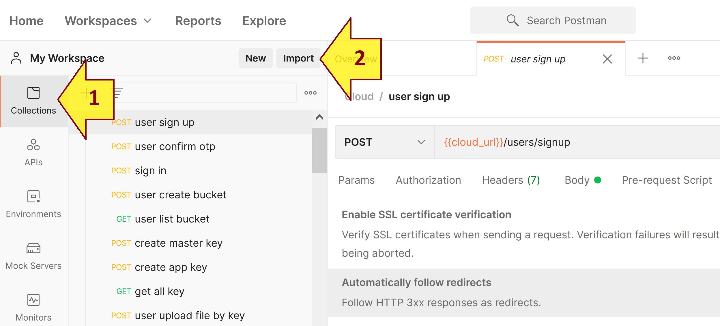
7. Import Postman Collection
https://identity.getpostman.com/signup

Slide 14
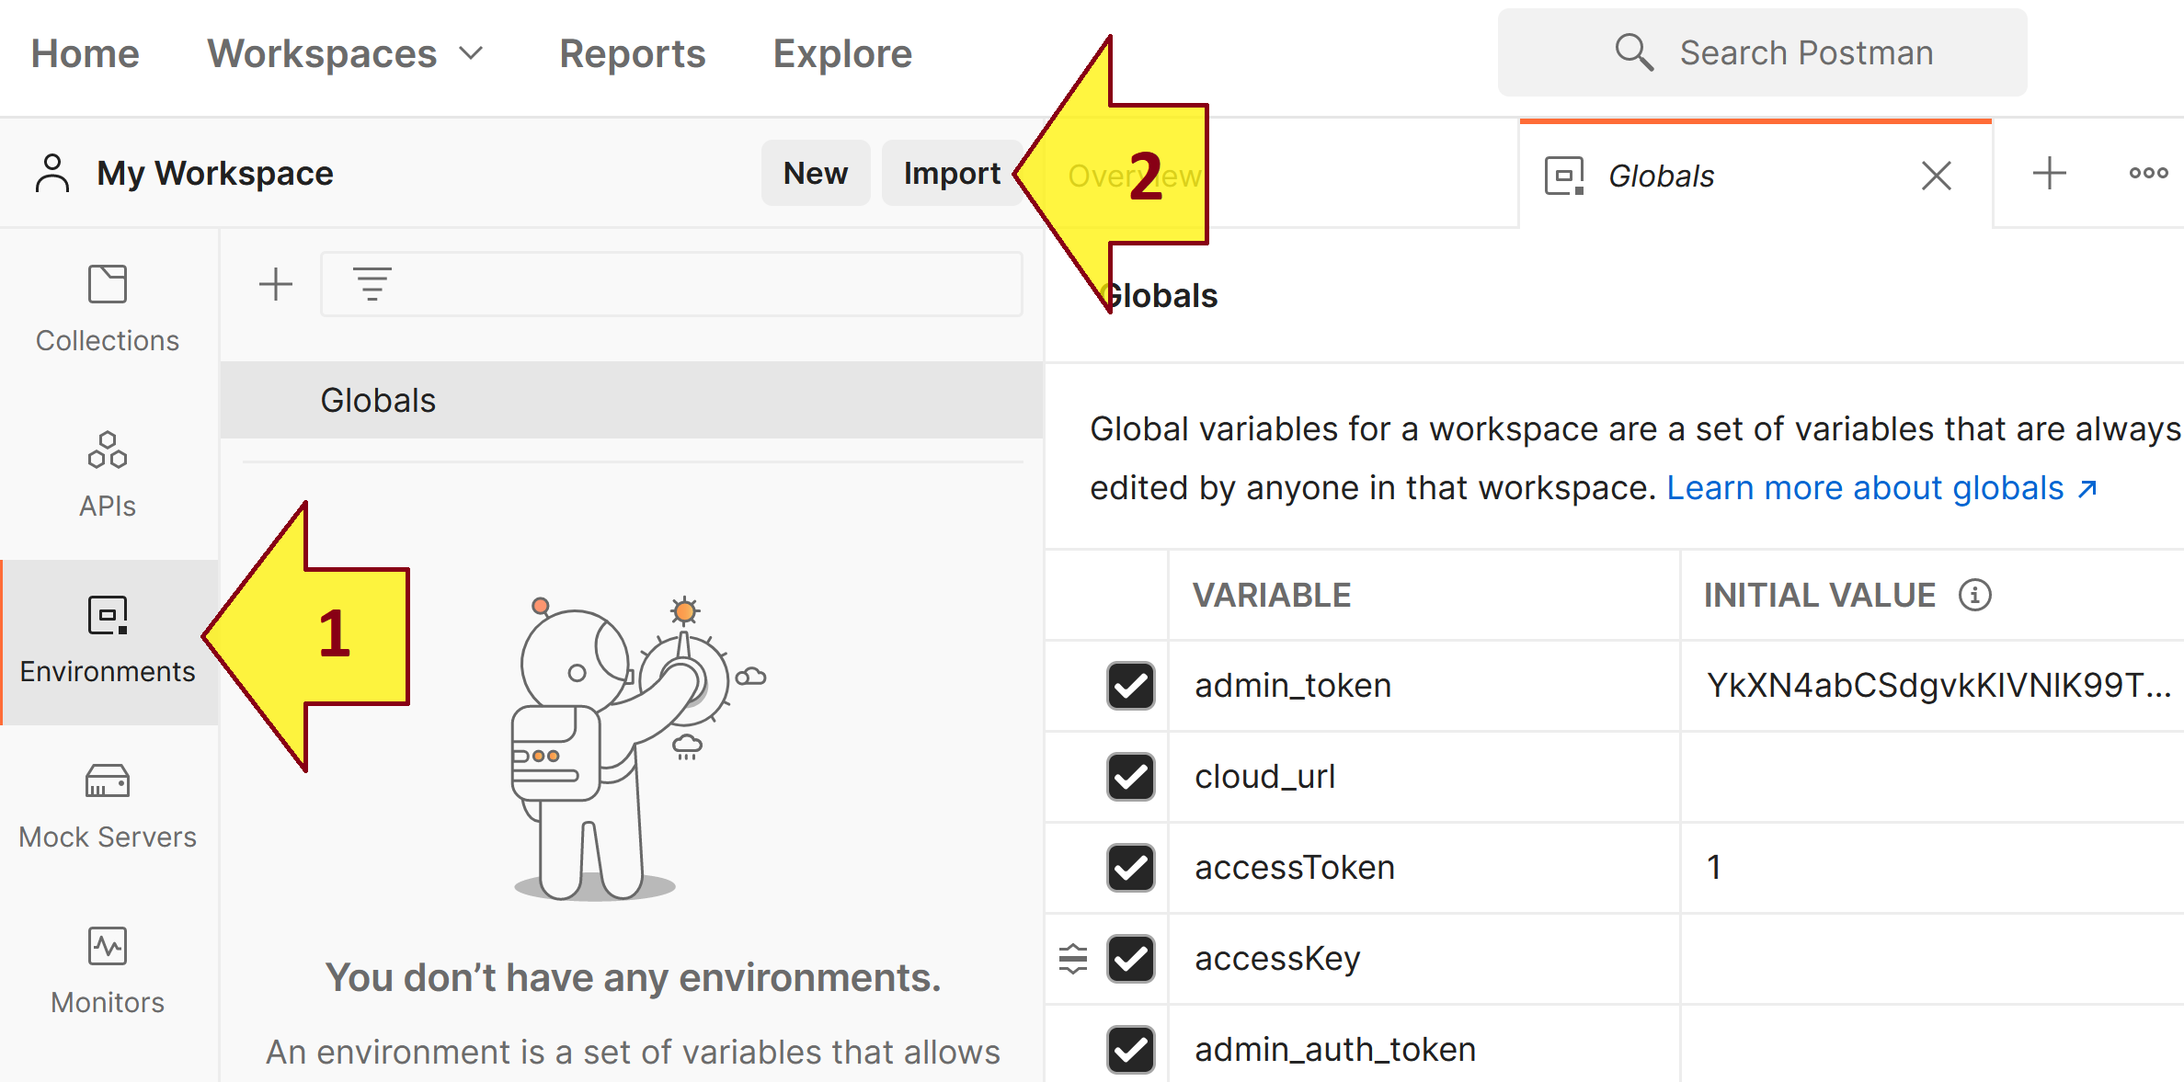
8. Import Postman Environment

Slide 15
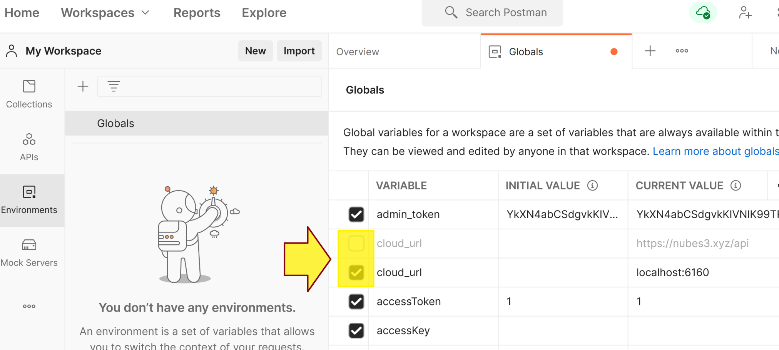
9. Switch Between Instances
https://web.postman.co/ → Workspaces

Slide 16
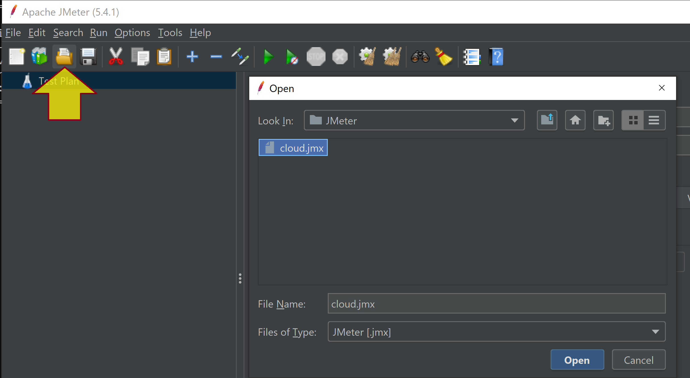
10. Import Jmeter Test Plan
https://jmeter.apache.org/download_jmeter.cgi → jmeter.bat

Slide 17


Slide 18
MooseFS
https://moosefs.com/download/
MooseFS is a Fault-tolerant, Highly available, Highly performing, Scaling-out, Network distributed file system. It spreads data over several physical commodity servers, which are visible to the user as one virtual disk. It is POSIX compliant and acts like any other Unix-like file system supporting:
Hierarchical structure: Files and Folders,
File attributes,
Special files: Pipes, Sockets, Block and Character devices,
Symbolic and Hard links,
Security attributes and ACLs.
It works with all applications that require a standard file system.

Slide 19

Thank You & See You Again

